Slide 1
Capstone Project - The Battle of Neighbourhoods
By Mudundi Sri Harsha
Email: harsha8745@gmail.com

Slide 2
Introduction/Business Problem
New York City and the city of Toronto are very diverse and are the financial capitals of their respective countries. Since we already explored certain boroughs of New York City and the city of Toronto and segmented and clustered their neighbourhoods, this time let’s try to cluster whole city and their entire neighbourhoods to find similarities among them.
The aim of this project is to build a guide which will show which neighbourhoods are similar between these two cities. This can be helpful for businesses that are trying to expand from one city to another or for people trying to relocate from one city to another and doesn’t want to miss out the amenities they had in the previous city.

Slide 3
Data
New York Data
New York has a total of 5 boroughs and 306 neighbourhoods. In order to segment the neighbourhoods and explore them, we will essentially need a dataset that contains the 5 boroughs and the neighbourhoods that exist in each borough as well as the the latitude and longitude coordinates of each neighbourhood.
The following json file has been used to obtain the data about the neighbourhoods in New York.
Source: https://cf-courses-data.s3.us.cloud-object-storage.appdomain.cloud/IBMDeveloperSkillsNetwork-DS0701EN-SkillsNetwork/labs/newyork_data.json
Geopy library was used to get the latitude and longitude values of New York City.

Slide 4
Toronto data
Toronto has a total of 10 boroughs and 103 neighbourhoods. In order to segment the neighbourhoods and explore them, we will essentially need a dataset that contains the 10 boroughs and the neighbourhoods that exist in each borough as well as the the latitude and longitude coordinates of each neighbourhood.
Web scraping was used to acquire the data about neighbourhoods in Toronto, from the following source
Source: https://en.wikipedia.org/wiki/List_of_postal_codes_of_Canada:_M
Sometimes geopy is not reliable in retrieving coordinates, so for getting coordinates of all the neighbourhoods in Toronto the following source was used
Source of geographical coordinates of the neighbourhoods in Toronto: http://cocl.us/Geospatial_data
Geopy library was used to get the latitude and longitude values of Toronto

Slide 5
Foursquare API
Foursquare API was utilizing the to explore the neighbourhoods and to get the data about venues and segment them.

Slide 6
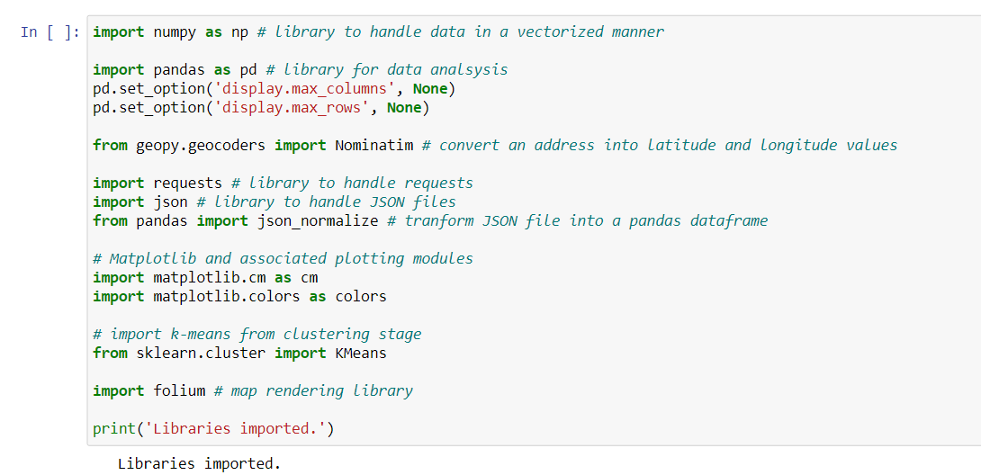
Methodology
The required libraries were loaded

Slide 7
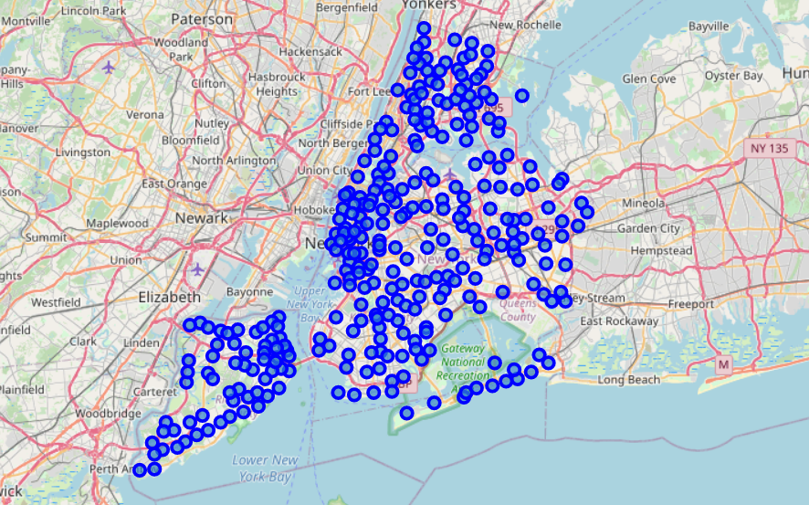
Features data from the downloaded new york json file was loaded into a data frame
Data wrangling was done to extract 'Borough', 'Neighborhood', 'Latitude', 'Longitude' data of various neighbourhoods in ney york city
The coordinates of ney york city were obtained using geopy library
Folium was used to create a map of the new york city and neighbourhood’s superimposed on top.

Slide 8
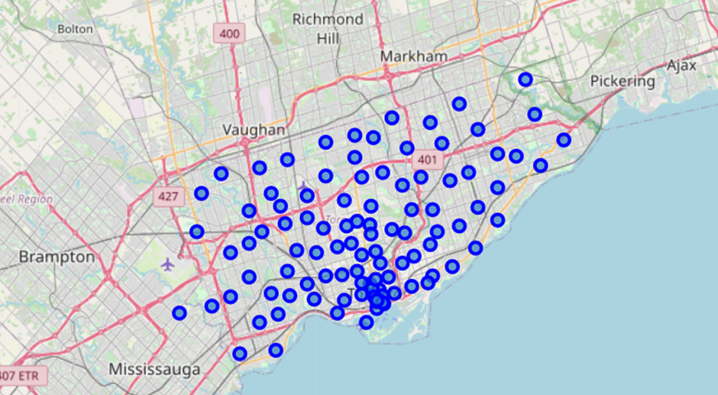
Now toronto data was acquired using web scraping with the help of pandas library
Data wrangling was done to remove bouroghs which were not not assigned.
File containing geographical coordinates of the neighborhoods in toronto was loaded as a data frame
The data was merged inorder to obtain 'Borough', 'Neighborhood', 'Latitude', 'Longitude' data of various neighbourhoods in city of toronto
The coordinates of city of toronto were obtained using geopy library
Folium was used to create a map of the city of toronto and neighbourhood’s superimposed on top.

Slide 9
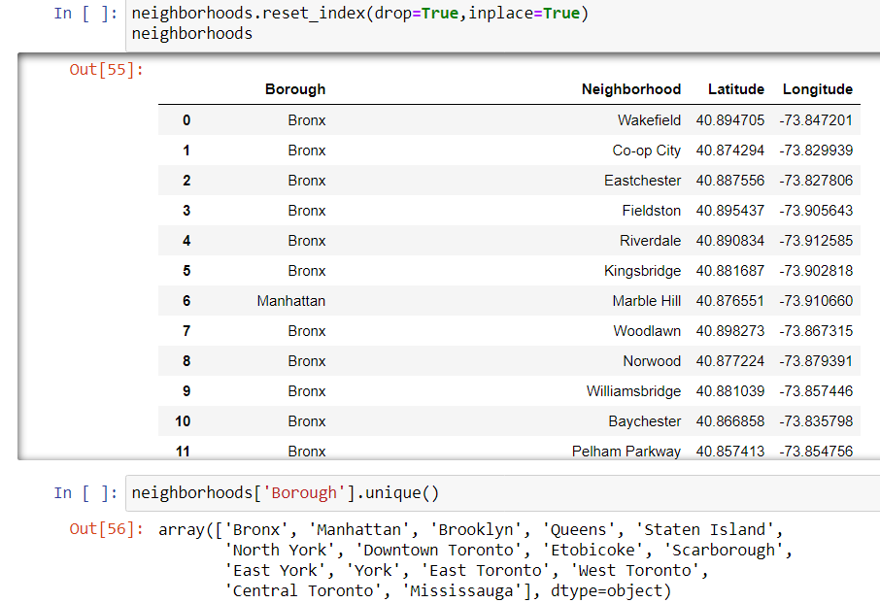
Now both Ney york data and city of toronto were merged together with column containing 'Borough', 'Neighborhood', 'Latitude', 'Longitude' data of various neighbourhoods

Slide 10
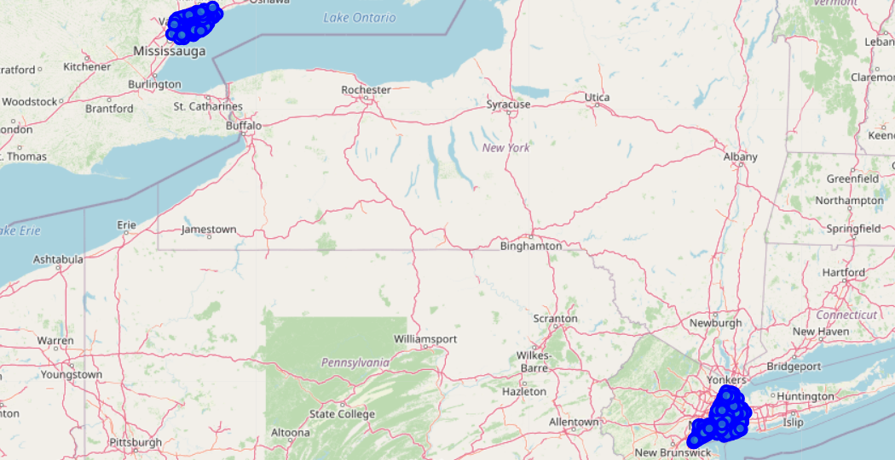
Folium was used to create a map of the combined data and neighbourhood’s superimposed on top.

Slide 11
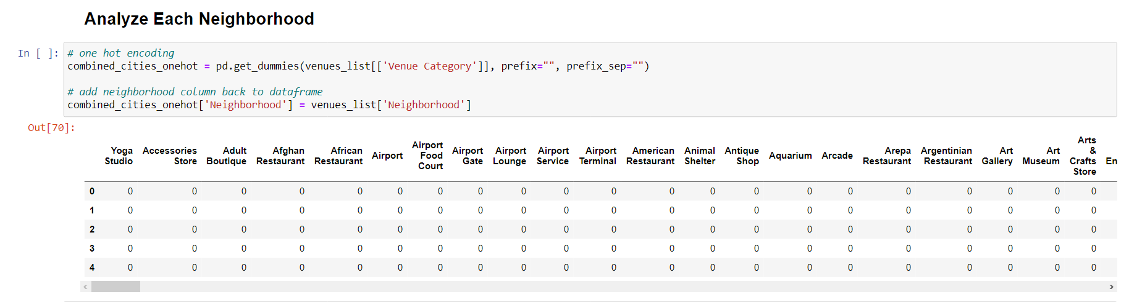
Foursquare was used to get the data of all venues in the neighborhoods. This was done by passing the credentials and query into the uri of the foursquare api
One hot encoding was done to convert categorical variables into dummies.

Slide 12
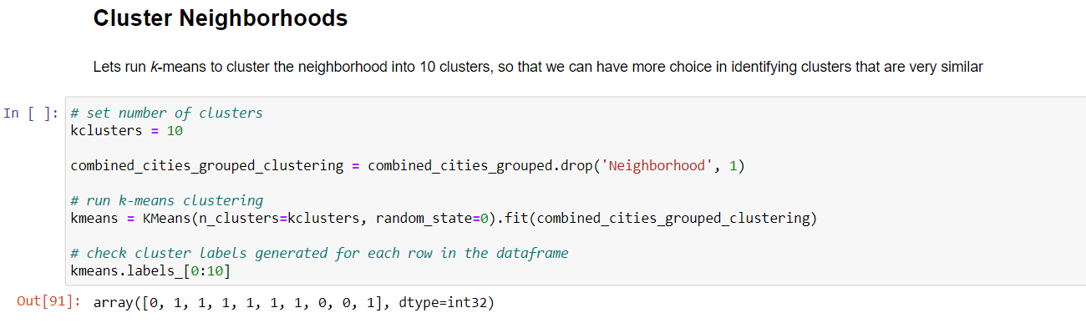
The data was grouped rows by neighborhood and by taking the mean of the frequency of occurrence of each category
K means was for clustering because its fast and efficient in analysing large sized databases
K was set to 10 clusters, so that we can have more choice in identifying clusters that are very similar

Slide 13
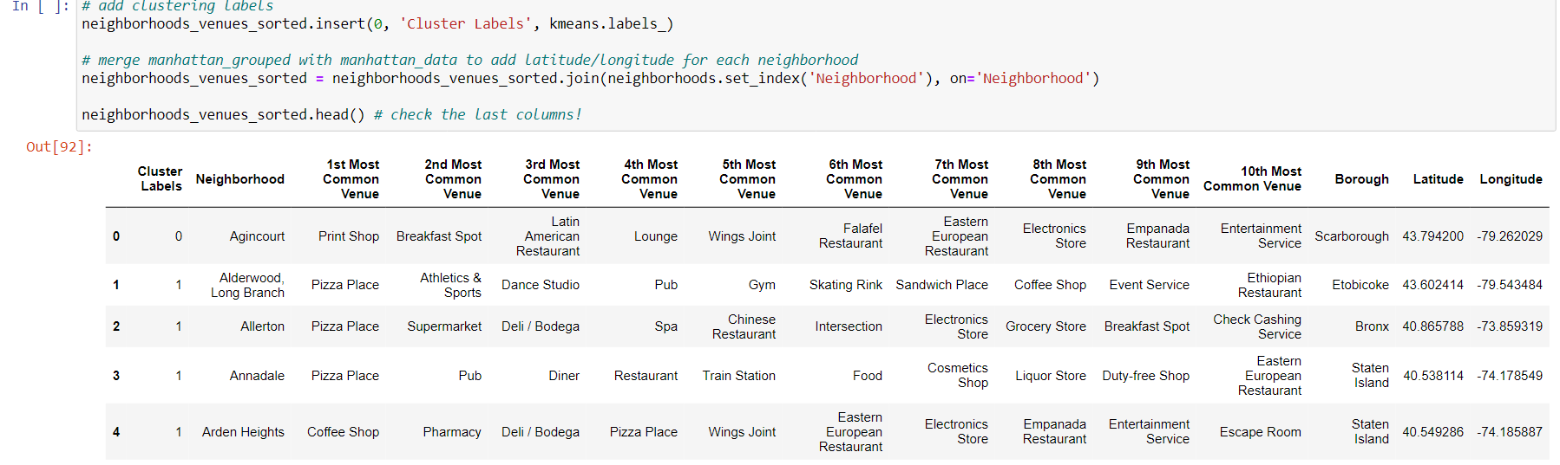
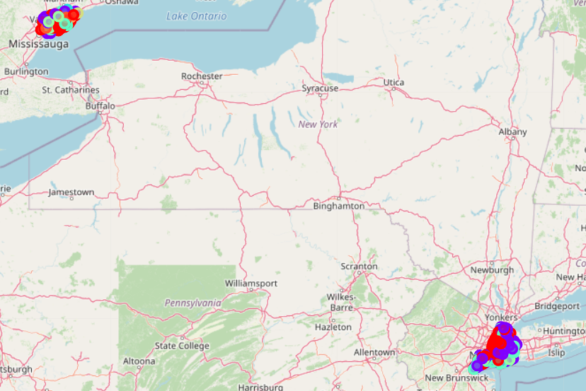
The labels data was visualized using folium as shown below

Slide 14
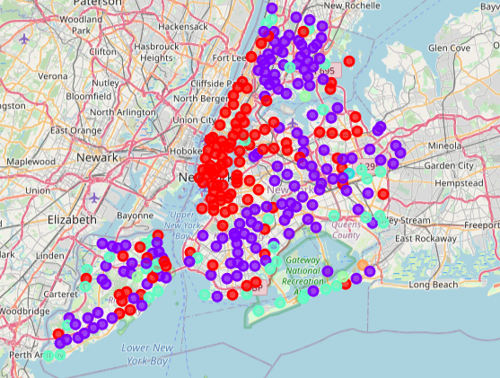
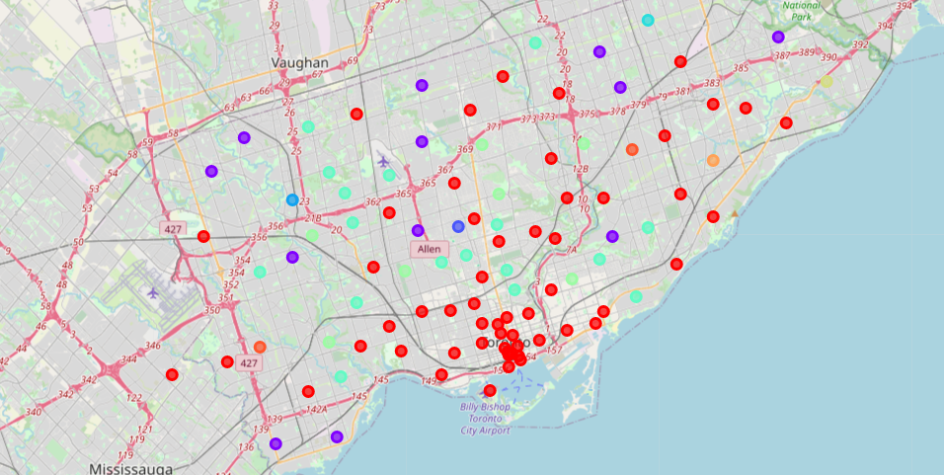
Fig: Close view at the clusters of New york city created using folium
Fig: Close view at the clusters of city of toronto created using folium

Slide 15
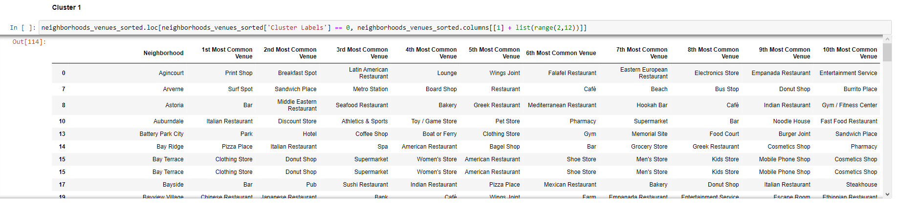
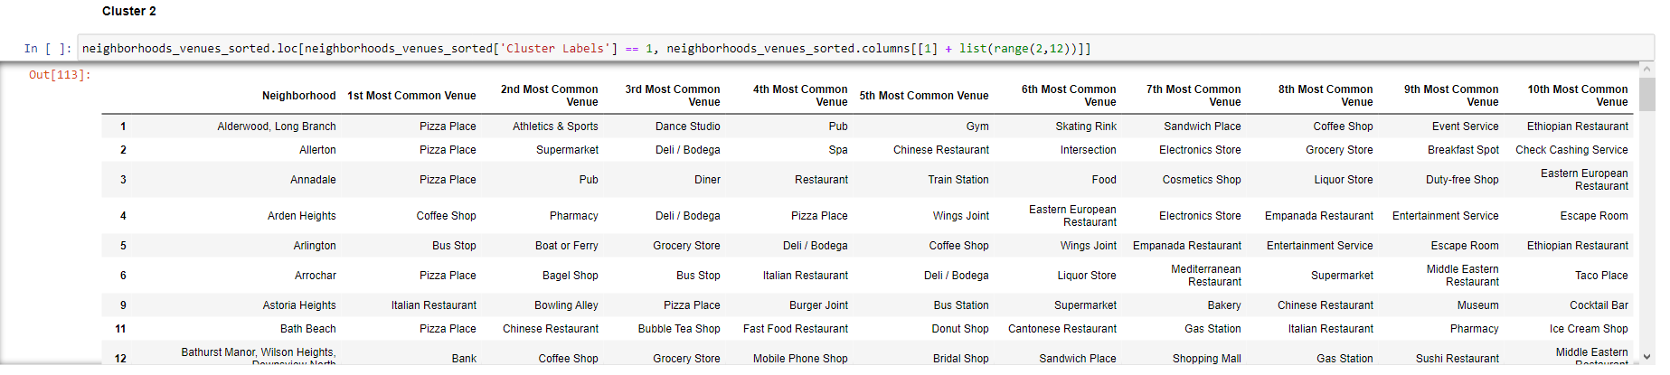
Results and discussion
The following clusters were obtained:

Slide 16
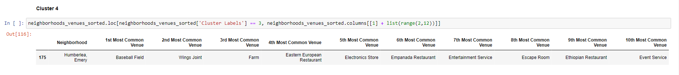

Slide 17
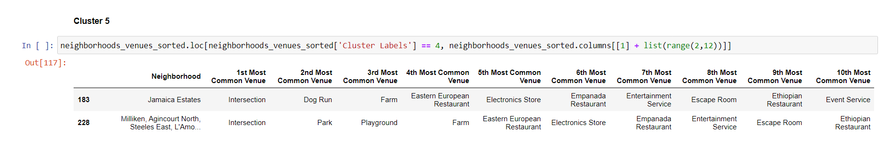
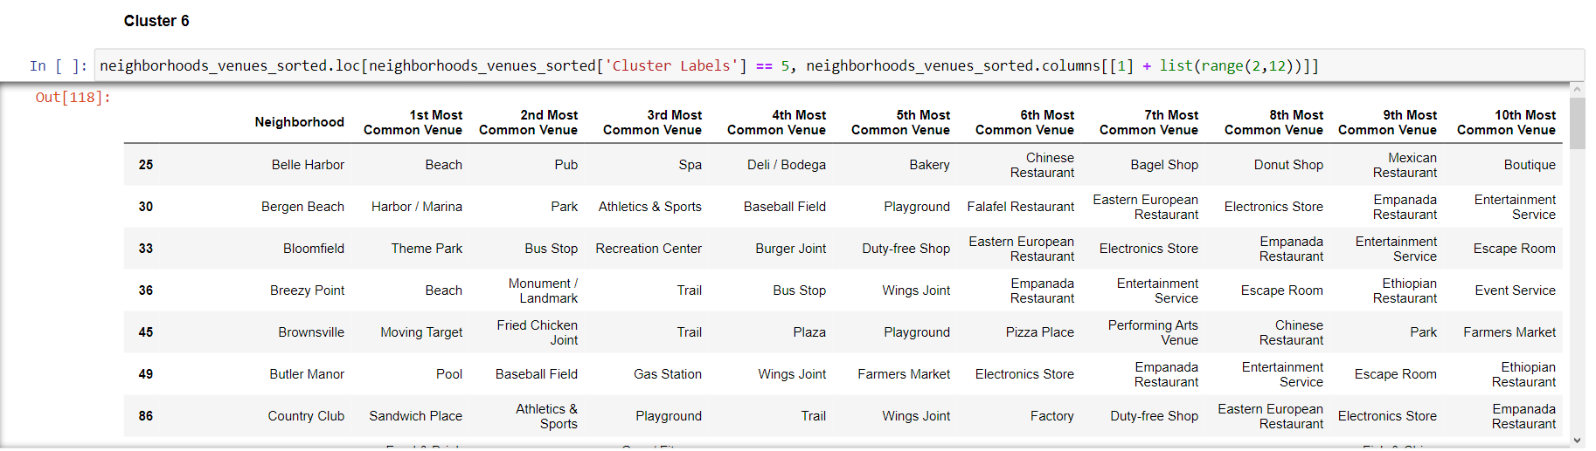

Slide 18
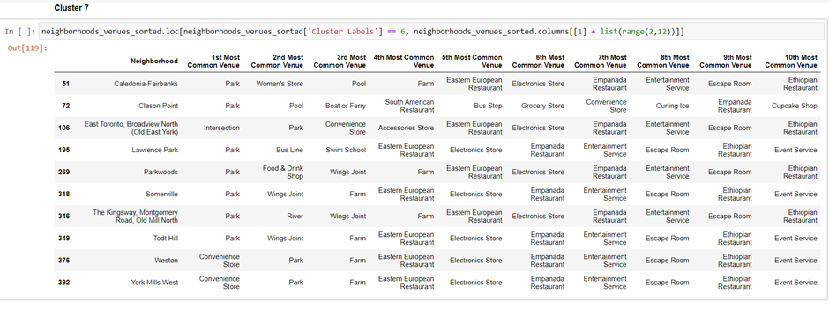
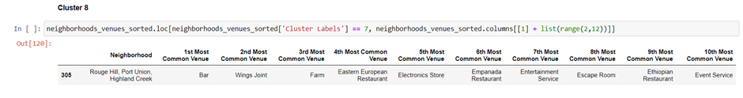

Slide 19
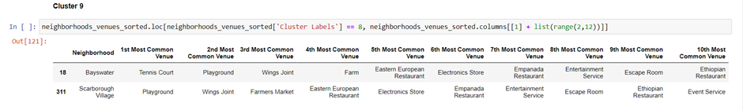
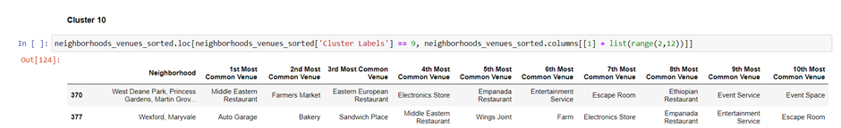

Slide 20
Clusters 3,4,8 are unique to their city as they have only one neighborhood
Clusters 5,9 has two neighborhoods,each one belonging to different cities.
Cluster 10 has two neighborhoods both belonging to Toronto
Cluster 7 has 10 neighborhoods, of which some belong to New York city and the rest belonging to Toronto city
Cluster 6 has 57 neighborhoods, of which some belong to New York city and the rest belonging to Toronto city
Cluster 2 has 160 neighborhoods, of which some belong to New York city and the rest belonging to Toronto city
Cluster 1 has 167 neighborhoods(the maximum), of which some belong to New York city and the rest belonging to Toronto city
As we can see most of the neighbourhoods fall into cluster 1 and 2 due to the high frequency of venues like coffee shops,cafe,gym, parks, bakery, lounges etc.

Slide 21
Conclusion
We have successfully clustered neighbourhoods of Ney york city and City of Toronto using K-Means machine learning algorithm, location data provided by foursquare and several python libraries like pandas for data wrangling , folium for vizualisation , geopy for getting get coordinates.
These obtained clusters can be used by the people relocating from one city to another city, to find the neighborhoobs with similar amenities to their previous city.
They can be also used for creating business oppurtunities like finding clusters with low frequency of a certain venue and high polulation density.

Slide 22
THANK YOU

